Slide 1

Scripting Languages
Module 9
Writing More Complex
Bash Scripts

Slide 2
Contents
Solution brief deconstruction
Documenting essential criteria
Identifying solution modules
Mapping module sequence
Selecting commands, tools and utilities
Modular coding techniques
Solution testing
Version control
Code encapsulation in functions

Slide 3
Learning Outcomes
After finishing this module, you should be able to:
Deconstruct a solution brief
Document essential criteria
Map and sequence solution modules
Select commands, tools and utilities
Code in a modular fashion
Test modules in isolation and when integrated
Use version control
Encapsulate common code in functions

Slide 4


Key Steps

Slide 5
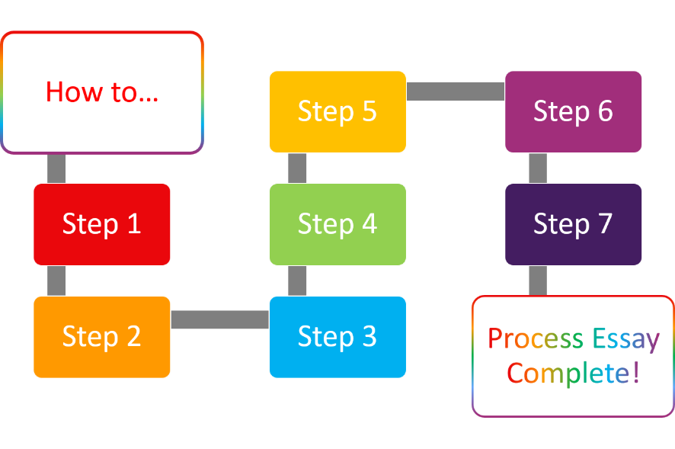
Key Steps
Desconstruct and document the solution brief carefully
Identify modules and their sequence in the script’s execution
Select commands, tools and utilities best suited to achieving the required outcomes
Code in a modular fashion
Test, test, and then test again
Use versioning to backtrack when things go wrong
Encapsulate common code in functions
BEGIN
DONE

Slide 6
Deconstruct
& Document

Slide 7
Deconstruct and Document
Look for verbs and adjectives that identify expected deliverables
Download a specific thumbnail…
Download ALL thumbnails…
Download images in a range …
Download a specified number of images… 5 random images in the specified range … will be downloaded
Make checklists out of stipulated assessment criteria
Each of the command line functions should work
Errors should be trapped so incorrect inputs cannot kill the code
...
Display correct messages
Professional code commenting
Code formatting for readability

Slide 8
Identify Modules
& Sequence

Slide 9
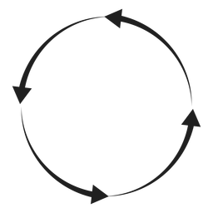
Modules & Sequence
7 EXIT
1 CONNECT TO SOURCE
Step 1
Step 2
…
Step 1
Step 2
…
OR
6 REPORT/DISPLAY RESULT(S)
2 CONSTRUCT USER MENU
Step 1
Step 2
…
Step 1
Step 2
…
3 PROMPT FOR USER INPUT
5 EXECUTE SELECTED TASK(S)
Step 1
Step 2
…
Step 1
Step 2
…
4 VALIDATE USER INPUT
Step 1
Step 2
…

Slide 10
Select Commands, Tools & Utlities

Slide 11
Select
7 EXIT
1 CONNECT TO SOURCE
Step 1
Step 2
…
Step 1
Step 2
…
wget
curl
IFS
read
OR
6 REPORT/DISPLAY RESULT(S)
2 CONSTRUCT USER MENU
Step 1
Step 2
…
Step 1
Step 2
…
dynamic, set and default variables
while
for
until
C-style counters
Logical Tests:
numbers
strings
file
directories
case
if-elif-fi
3 PROMPT FOR USER INPUT
5 EXECUTE SELECTED TASK(S)
custom functions
Step 1
Step 2
…
Step 1
Step 2
…
4 VALIDATE USER INPUT
sed
grep
awk
Step 1
Step 2
…
BRE/ERE input validation

Slide 12
Code Modularly

Slide 13

Code Modularly
1 CONNECT TO SOURCE
2 CONSTRUCT USER MENU
3 PROMPT FOR USER INPUT
4 VALIDATE USER INPUT
Step 1
Step 2
…
Step 1
Step 2
…
Step 1
Step 2
…
Step 1
Step 2
…
5 EXECUTE SELECTED TASK(S)
6 REPORT/DISPLAY RESULT(S)
7 EXIT
Step 1
Step 2
…
Step 1
Step 2
…
Step 1
Step 2
…

Slide 14
Test in Isolation and When Integrated

Slide 15
Test
7 EXIT
1 CONNECT TO SOURCE
Step 1
Step 2
…
Step 1
Step 2
…
OR
6 REPORT/DISPLAY RESULT(S)
2 CONSTRUCT USER MENU
Step 1
Step 2
…
Step 1
Step 2
…
3 PROMPT FOR USER INPUT
5 EXECUTE SELECTED TASK(S)
Step 1
Step 2
…
Step 1
Step 2
…
4 VALIDATE USER INPUT
Step 1
Step 2
…

Slide 16
Test
7 EXIT
1 CONNECT TO SOURCE
Step 1
Step 2
…
Step 1
Step 2
…
OR
6 REPORT/DISPLAY RESULT(S)
2 CONSTRUCT USER MENU
Step 1
Step 2
…
Step 1
Step 2
…
3 PROMPT FOR USER INPUT
5 EXECUTE SELECTED TASK(S)
Step 1
Step 2
…
Step 1
Step 2
…
4 VALIDATE USER INPUT
Step 1
Step 2
…

Slide 17
Test
7 EXIT
1 CONNECT TO SOURCE
Step 1
Step 2
…
Step 1
Step 2
…
OR
6 REPORT/DISPLAY RESULT(S)
2 CONSTRUCT USER MENU
Step 1
Step 2
…
Step 1
Step 2
…
3 PROMPT FOR USER INPUT
5 EXECUTE SELECTED TASK(S)
Step 1
Step 2
…
Step 1
Step 2
…
4 VALIDATE USER INPUT
Step 1
Step 2
…

Slide 18
Test
7 EXIT
1 CONNECT TO SOURCE
Step 1
Step 2
…
Step 1
Step 2
…
OR
6 REPORT/DISPLAY RESULT(S)
2 CONSTRUCT USER MENU
Step 1
Step 2
…
Step 1
Step 2
…
3 PROMPT FOR USER INPUT
5 EXECUTE SELECTED TASK(S)
Step 1
Step 2
…
Step 1
Step 2
…
4 VALIDATE USER INPUT
Step 1
Step 2
…

Slide 19
Test
7 EXIT
1 CONNECT TO SOURCE
Step 1
Step 2
…
Step 1
Step 2
…
OR
6 REPORT/DISPLAY RESULT(S)
2 CONSTRUCT USER MENU
Step 1
Step 2
…
Step 1
Step 2
…
3 PROMPT FOR USER INPUT
5 EXECUTE SELECTED TASK(S)
Step 1
Step 2
…
Step 1
Step 2
…
4 VALIDATE USER INPUT
Step 1
Step 2
…

Slide 20
Test
7 EXIT
1 CONNECT TO SOURCE
Step 1
Step 2
…
Step 1
Step 2
…
OR
6 REPORT/DISPLAY RESULT(S)
2 CONSTRUCT USER MENU
Step 1
Step 2
…
Step 1
Step 2
…
3 PROMPT FOR USER INPUT
5 EXECUTE SELECTED TASK(S)
Step 1
Step 2
…
Step 1
Step 2
…
4 VALIDATE USER INPUT
Step 1
Step 2
…

Slide 21
Test
7 EXIT
1 CONNECT TO SOURCE
Step 1
Step 2
…
Step 1
Step 2
…
OR
6 REPORT/DISPLAY RESULT(S)
2 CONSTRUCT USER MENU
Step 1
Step 2
…
Step 1
Step 2
…
3 PROMPT FOR USER INPUT
5 EXECUTE SELECTED TASK(S)
Step 1
Step 2
…
Step 1
Step 2
…
4 VALIDATE USER INPUT
Step 1
Step 2
…

Slide 22
Test
7 EXIT
1 CONNECT TO SOURCE
Step 1
Step 2
…
Step 1
Step 2
…
OR
6 REPORT/DISPLAY RESULT(S)
2 CONSTRUCT USER MENU
Step 1
Step 2
…
Step 1
Step 2
…
3 PROMPT FOR USER INPUT
5 EXECUTE SELECTED TASK(S)
Step 1
Step 2
…
Step 1
Step 2
…
4 VALIDATE USER INPUT
Step 1
Step 2
…

Slide 23


Test
1 CONNECT TO SOURCE
2 CONSTRUCT USER MENU
3 PROMPT FOR USER INPUT
4 VALIDATE USER INPUT
Step 1
Step 2
…
Step 1
Step 2
…
Step 1
Step 2
…
Step 1
Step 2
…
7 EXIT
6 REPORT/DISPLAY RESULT(S)
5 EXECUTE SELECTED TASK(S)
Step 1
Step 2
…
Step 1
Step 2
…
Step 1
Step 2
…

Slide 24
Use Version Control

Slide 25
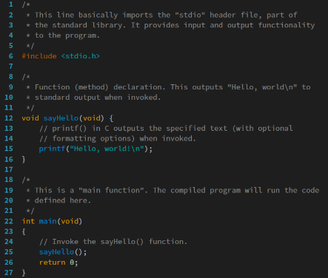
Use Versioning
myscript_v01.sh
myscript_v02.sh
myscript_v03.sh
myscript_v04.sh
Each time you get a code block working, save as new version before proceeding, e.g. myscript_v01.sh Save As myscript_v02.sh
This gives you the ability to return to an earlier working version of your script should things go wrong in later versions
Describe what has been achieved/done in each versions with comments at the top to remind yourself
Keep your versions safe – git is perfect for this

Slide 26
Encapsulate Common Code in Functions

Slide 27
Use Functions for common code
As you have learned, Functions are particularly useful for aggregating sets of commands that are frequently required in bash scripts
Identify code blocks and sequences that will be used by several or perhaps all modules and encapsulate these in functions of your own definition
Place these functions into the head region of your script so that they can be called upon by name if and when they are required in the script’s execution
Advantages of Functions
Avoid time-consuming repetition of commonly used code. Make scripts, especially complex scripts, more readable. Allow complex coding tasks to be broken down into much simpler ones. Reduce the likelihood of error – get right the first time, then reuse. Maintaining and updating scripts is much easier when core parts of it are comprised by common functions.

Slide 28
References and Further Reading
Ebrahim, M. & Mallet, A. (2018). Mastering Linux Based Scripting. (2nd Ed)

